Slide 1

Better Together Forum
Ageing Well
Amanda Healy
Director of Public Health

Slide 2

Progress to date
Ageing Well Health Needs Assessment completed summer 2022 (completed by Rebekka Shenfine, Speciality Registrar in Public Health). Aims of the HNA:
  To determine the health needs of older people aged 50 plus in County Durham and inform the development of a new ageing well action plan to reduce inequalities and improve health and wellbeing outcomes in this population
  Covered a wide range of priority areas using the World Health Organisation Age-Friendly Cities Framework – working across wider determinants of health such as social, behavioural, environmental and economic determinants alongside the impact of the physical environment rather than clinical pathways/frailty
  This approach enable health promotion and prevention activity across the life course

Slide 3
Progress to date
Key Findings of the HNA
Information and Advice - availability of information and alternative information formats
Transport - Accessibility of information and services especially those living in rural areas
Respect and Social Isolation - importance of viewing ageing in a positive light, and the effects of Covid-19 pandemic.
Social participation - role of co-production, intergenerational activity, volunteering and health literacy.
Housing and neighbourhoods - availability of suitable local housing close to family members, specific support for older tenants
Outdoor spaces and buildings - importance of making outdoor spaces and buildings ‘age-friendly, combatting anti-social behaviour, climate change effects on older people
Economic activity and civil engagement - effects of the rising costs of living and fuel poverty, age-friendly employment opportunities.
Health and wellbeing - helping people with long-term conditions to live their lives in better health and the need for services (e.g. sexual health, stop smoking and domestic violence) to meet the needs of people aged over 50.

Slide 4
Progress to date
The findings of the HNA led to a range of recommendations which have been shared with partners across the system. Work progressing to embed recommendations;
Findings have been shared with partners across the system
Recommendations have been embedded within the Ageing Well Partnership Plan
Public health guidance in development on key areas identified within the HNA to consider age as a protected characteristic on any equality impact assessment / new area of work (Age UK ambassadors have provided feedback on this). This will be shared with partners when finalised
Ageism campaign in development to encourage partners to challenge ageism in everyday conversation across the county – due end of May 2024
Discussions taking place to progress towards Age Friendly Communities accreditation

Slide 5
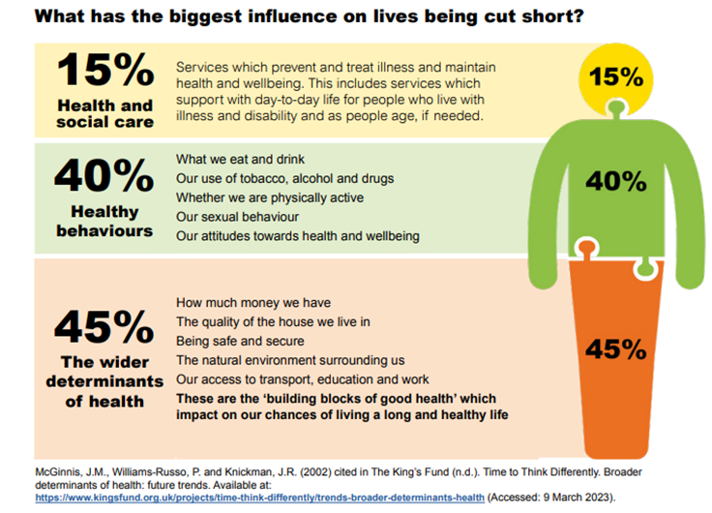
Joint Local Health and Wellbeing Strategy Priorities
Joint Local Health and Wellbeing Strategy
Wider Determinants of Health
Making Smoking History
Enabling Healthy Weight for All
Improving Mental Health, Resilience and Wellbeing
Reducing Alcohol Harms
Education and skills
Planning
Transport
Economy
Environment
Poverty
Housing
Culture

Slide 6



Vision
County Durham Together is about working with communities, especially those most in need, making sure they are at the heart of decision making, building on their existing skills, knowledge, experience and resources to support everyone to thrive and to live happy, healthy and connected lives.

Slide 7
CDT Animation

Slide 8
Voluntary and Community Sector Leadership Group
Creating a more sustainable voluntary and community sector in County Durham and act as a conduit for alignment of VCSE funding
Maximise and align cross sector investment into the voluntary and community sector.
Increase the knowledge and understanding within statutory bodies of the role and contribution of the VCSE sector at a local level.
Adapt/explore and test new ways of working together to invest in the VCSE/different approaches to commissioning the VCSE sector.
Make use of the sector’s insights and strengths to better meet population needs as a system.
Develop a VCSE investment framework or co-produced strategy for working with the VCSE sector and a delivery plan.
Support civic commissioners to review existing contracting relationships and opportunities for diversifying service providers including VCSE organisations.
Work towards a fundamental shift in culture, investment and process
Identify opportunities that encourage collaboration and that support the co-design of solutions, building on local capacity and strengths.
Gain support for, implement and oversee, Employer Supported Volunteering Schemes

Slide 9
Voluntary and Community Sector Leadership Group
Progress
First steps to alignment of strategic funders of VCSE
Broad agreement on “vision” for the future
Mapping of existing grants to VCS organisations across partners (including from ICB, Durham University, DCC)
Challenges
Demands from all partners on the VCSE and the way funding is distributed in silos
Uncertainty in longevity of funding commitments
Challenges in evaluation measures for VSCE funding recipients
Understanding barriers to good evaluation of initiatives
Next steps
Establishing Principles
Continued development of partners dashboard
Developing a “Commissioning” Guide for funders
Our Support Offer for VCSE Organisations
The Manchester Model – developing the Durham Model
  Comms
  Branding
  Project Resource

Slide 10
QUESTIONS/COMMENTS

