Slide 1
Hello and welcome….
Todays aims:
Recap on DMWA
Learn about Principles and Values
A brief overview of the services provided via DMWA
An update on DMWA plans re: performance

Slide 2
Alliance Contracting: A bit of background
In April 2021 Durham County Council re-tendered 21 of their mental health and wellbeing services and developed a new collaborative approach to a range of support services including prevention, early identification and recovery support.
This collaborative approach falls under the term ‘ alliance’
Alliance commissioning is a relatively new model in the care and support sector and in essence it’s a group of providers who come together to form an “alliance”, which is not a legal entity, but the principles are that we all pool our funding, resources and efforts together for the greater good. The Alliance leadership team has to agree upon everything unanimously and all decisions are made in the best interests of the service users.
This is a whole system approach, requiring commitment and determination to achieve positive outcomes for people across County Durham.
The Durham Mental Wellbeing Alliance went live in April 2022 and over the next 7year (7-year fixed contract with a 3-year extension) it will play a pivotal role in improving mental health and wellbeing across the county .
It will mean stability for providers, the potential to grow, and the amazing opportunity for us to be involved in something innovative and ground breaking in the region as we are the first alliance in the whole of the North East.

Slide 3
DMWA: Who are we?
The Alliance is made up of seven providers and our commissioning team:
Providers include: Commissioner lead DCC
Mental Health Matters Tricia Reed, Commissioning Manager.
Home group
Creative Support
St Margaret’s Centre
Richmond Fellowship
If U Care Share
Waddington Street Centre
We are: One voice, one Alliance
We are 7 providers who trust each other | We work together extensively, our relationships are strong
We have respect for the unique qualities each brings | We see the value in bringing our strengths and qualities together
We can’t do everything and we will need to change | We are all committed to this contract and to making it a success for our service users.

Slide 4
DMWA: Principles & Values
Aim: To build resilience, supporting people to thrive
Vision: To connect communities, drive innovation and empower people
Mission: To work together to improve mental health and wellbeing across County Durham
Values:
Empowerment: we will help people to be more confident and resilient
Accountability: together we share responsibility for delivering the best possible mental health services in Durham
Connection: we’re connected with each other, service users and with local communities
Innovation: we’ll change the way we work and transform our services
Through the above we will achieve shared outcomes for our service users.

Slide 5
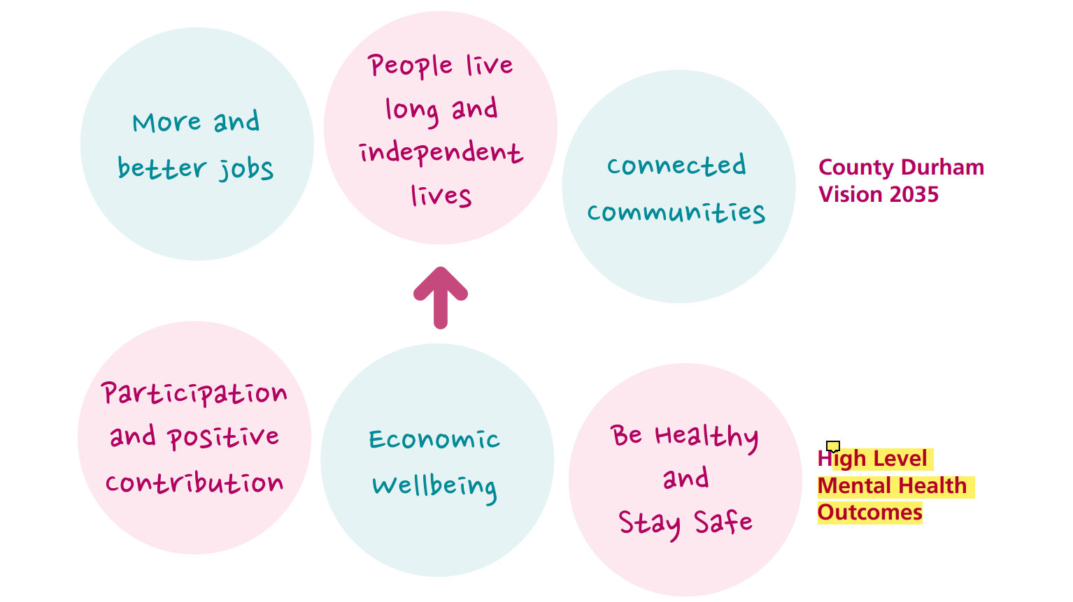
DMWA: High level outcomes

Slide 6
DMWA: We will be supported by a team of subcontractors, who will help us achieve our values and principles.
Our current Subcontractors are:
Aspire
Stanley PACT
Cruse Bereavement Support
Relate
Welfare Rights
Hub of Wishes

Slide 7
Services within the Alliance:

Slide 8
The Alliance offers a wide range of mental health and wellbeing services and supports over 1200 people per week.
Support offered includes:
Outreach
Support accommodation
Mental health hospital discharge
Volunteering
Befriending
Bereavement support
Vocational support including: Educational, training and employment support
Drop in / Centre based support
Open access groups
Suicide prevention
Relationship support
Welfare rights

Slide 9
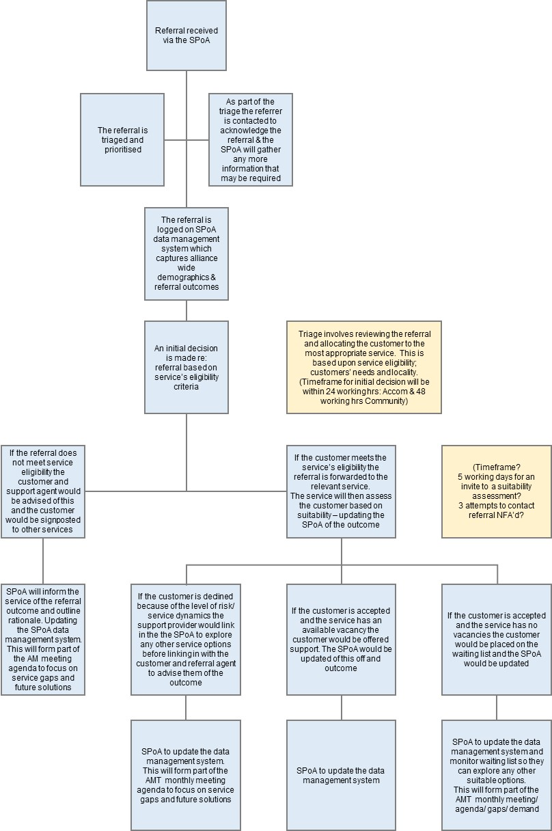
Single Point of Access:
The SPoA is a one stop shop where all Alliance enquiries and referrals will be processed.
The SPoA plays a pivotal role in getting people to the service that is right for them across the county, managing waiting lists for all services, the SPoA staff will evaluate referrals so that if there is no availability, they can offer immediate advice or direct the service user to a service with capacity.
The SPoA operates between the Hours of 09.00am to 17.00pm Monday to Friday (excluding Bank Holidays) the inbox will be attended by the Referral Coordinators throughout the day whereby incoming referrals will be triaged and prioritised within 24 (working) hours of receipt for accommodation services and 48 (working) hours for community based services.
If a referral comes for a service user who is homeless/ safeguarding needs this will take priority and we will ensure the customer is safe and has a support mechanism in place before shift finish.
Referrals can be made from anyone including, health professionals, voluntary sector organisations or agency workers within the locality. We also accept self-referrals directly from individuals wishing to access support.​
The SPoA email address is:
Referrals2DMWA@homegroup.org.uk

Slide 10
Duplication, Gaps and Demand
The SPoA will help the alliance complete a demand and gap analysis in which DMWA will consider:
What is already being delivered
Interdependencies with other services
Eligibility and capacity of other services
Subcontract length
Analysis will be data and demand led, based on the work delivered via SPoA and working with subcontractors, stakeholders in social care, health, housing, service users and other providers
Where services are already being provided, we’ll work alongside them, not duplicate them
All decisions will be made by the ALT in co-production with our service users and informed by service user need.
The stakeholder and service user boards will help us map and understand gaps and duplication

Slide 11
DMWA Co-production:

Slide 12
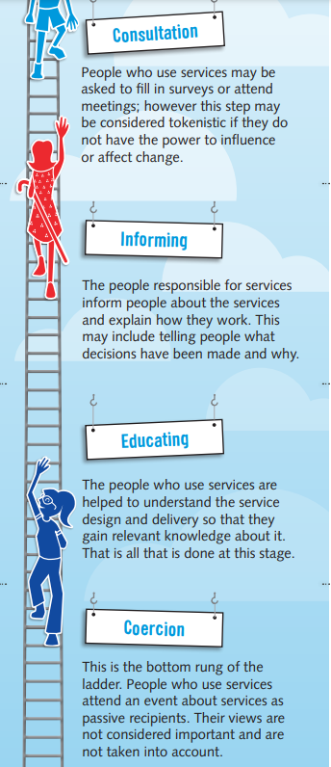
Our Service Users are important. We believe that people with lived experience have the best ideas about services which are important and work.
We will actively engage our service users at Co-Design and Co-Production levels.
To do this we intend to hold training, regular focus groups and planning events in the coming months
From these sessions we will develop Reps who will help us to review and design services for the DMWA.
We also want to showcase the many talents of our service users by using their creative outputs in our publicity materials, via an annual celebration and community art exhibitions or performances.
“When we do change to people, they experience it as violence. But when people do change to themselves, they experience it as liberation”.
Rosabeth Moss Kanter – Harvard Business School

Slide 13
DMWA Governance:

Slide 14
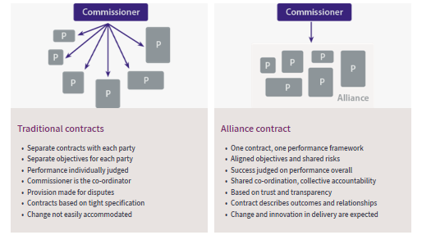
Alliance agreement:
Provider Collaboration Agreement:
Obligations and liabilities flowed down from the Alliance Agreement to set out how these are delivered and governed between the Providers
The PCA is for Providers only and sets out how we work together to enable the delivery of mental health services under the Alliance Agreement

Slide 15
Alliance Leadership Team:
The Alliance Leadership Team has been established to provide strategic direction to the alliance, to manage risk and to hold to account the Alliance Management Team for the performance of the alliance such that it achieves the Alliance Objectives as set out in the Alliance agreement and PCA.
Provider: | Leadership team:
Creative Support | Gail Dawson
Home Group | Deanne Cafferkey
If U Care Share | Marie Field
Mental Health Matters | Sonia McGough
Richmond Fellowship | Karyn Ainsley
St Margaret’s Centre | Rob Chatwin
Waddington Street Centre | Ali Lee
General responsibilities
establish and ensure the strategic leadership and direction of Our Alliance;
establish and implement the governance and accountability structures for Our Alliance;
ensure the performance of Our Alliance;
promote the Alliance Purpose, Alliance Principles and Alliance Values and Behaviours;
appoint and empower the Alliance Manager and Alliance Management Team to deliver the Alliance Objectives;
promptly resolve any dispute elevated to it by the Alliance Management Team on a Best for People using Service basis;
have a shared responsibility for the identification and delivery of additional and/or new services that improve the experience of Service Users, within the available Funding Envelope;
acknowledge and accept that the Alliance Leadership Team may seek to shift activity in order to achieve the Alliance Objectives and the Alliance Purpose.
be responsible for determining both the ALT Terms of Reference and the AMT Terms of Reference;

Slide 16
Alliance Management Team:
The Alliance Management Team has been established to manage the alliance, particularly in respect of the delivery of plans to achieve the Alliance Objectives and strategies agreed by the Alliance Leadership Team, and to manage performance and risk.
General Responsibilities
deliver the Services and meet or exceed the Alliance Objectives;
provide day to day management and leadership of the Services; and
promote the Alliance Purpose, the Alliance Principles and the Alliance Values and Behaviours.
Provider: | Management team:
Creative Support | Chu-Chu Nwajiobi
Home Group | Edward Finn Joanne Hall Kara Maddison
If U Care Share | Hannah Neil
Mental Health Matters | Jackie Holme
Richmond Fellowship | Laura Bryant Gail McGee
St Margaret’s Centre | Lisa Harrison
Waddington Street Centre | Steve Wakefield

Slide 17
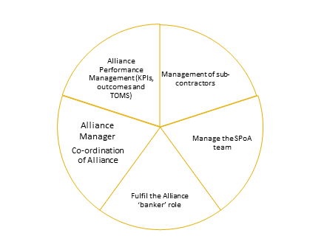
Central Management Team:
The CMT ensures the smooth operation of Alliance principles and protocols. Reporting into the Alliance Leadership Team the CMT consists of an:
Alliance Manager – Julie Cane appointed by the Alliance Leadership Team to lead the Alliance Management Team
Alliance Performance Coordinator - David Robinson
The CMF manages how the Alliance as a whole is perceived both internally and externally, ensuring all activity holds fidelity to the overarching Alliance principles
The CMF will ensure DMWA;
Meets the requirements of the Alliance agreement, specifically the financial and performance frameworks
Delivers cost effective, high quality services across County Durham
Evolves and grows – completing a continuous gaps and demand analysis to feedback to the ALT
The CMF will;
Provide a ‘ go to’ person/s for all alliance matters, with the Alliance Manager acting as the figure head across all member organisations and subcontractors. Communicating key messages to all providers.
Coordinate collate and process data
Oversee the financial envelope
Manage the SPoA central referral pathway for our customers – to prevent repetition and ensure they access the right service at the right time
Oversee the delivery and compliance of the Alliance contract and any sub-contractual obligations in conjunction with ALT leads.

Slide 18
There will be four workstreams which will feed into the ALT to ensure to ensure we have working systems that are County wide.
Each work stream will have a key role in ensuring we are meeting our mission, vision and outcomes.
Different member of the ALT will lead on these workstreams
These workstreams will ensure joined up decision making, better outcomes for all, integration at all levels, addressing gaps and demand and most importantly listening to our service users and volunteers and getting their input and feedback.
ALT
Strategic Stakeholder Board
Service User Board
Alliance Management Team
Sub contractors

Slide 19
DMWA Performance Plan:

Slide 20
During implementation, the ALT created lead workstreams .
The performance workstream set up sub groups working with providers to devise the first years KPIs and Outcomes for the alliance.
Accommodation
Outreach
Place Based
Vocational
 | Participation & positive contribution | Economic wellbeing | Be Healthy & Stay safe
Overall (example) | The Alliance will demonstrate on average, an improvement in the mental wellbeing reported by customers by …% on completion of service using the Warwick Edinburgh scale | As an Alliance we will demonstrate …% of customers feel supported in regards financial security? | The Alliance will demonstrate a ….% on average increase in the improvement of quality of life as reported by our customers

Slide 21
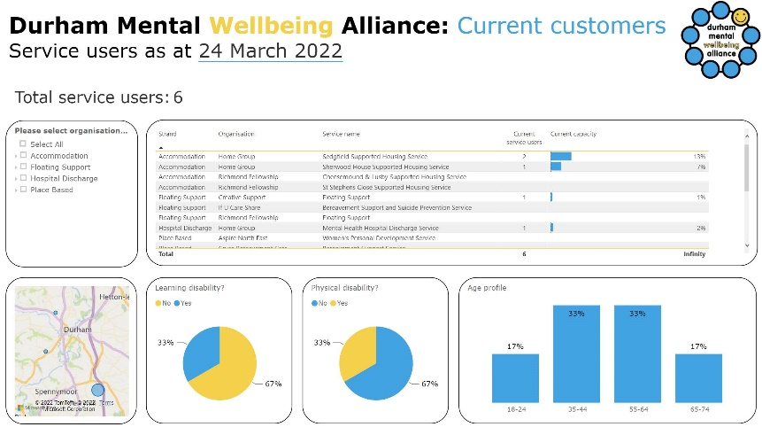
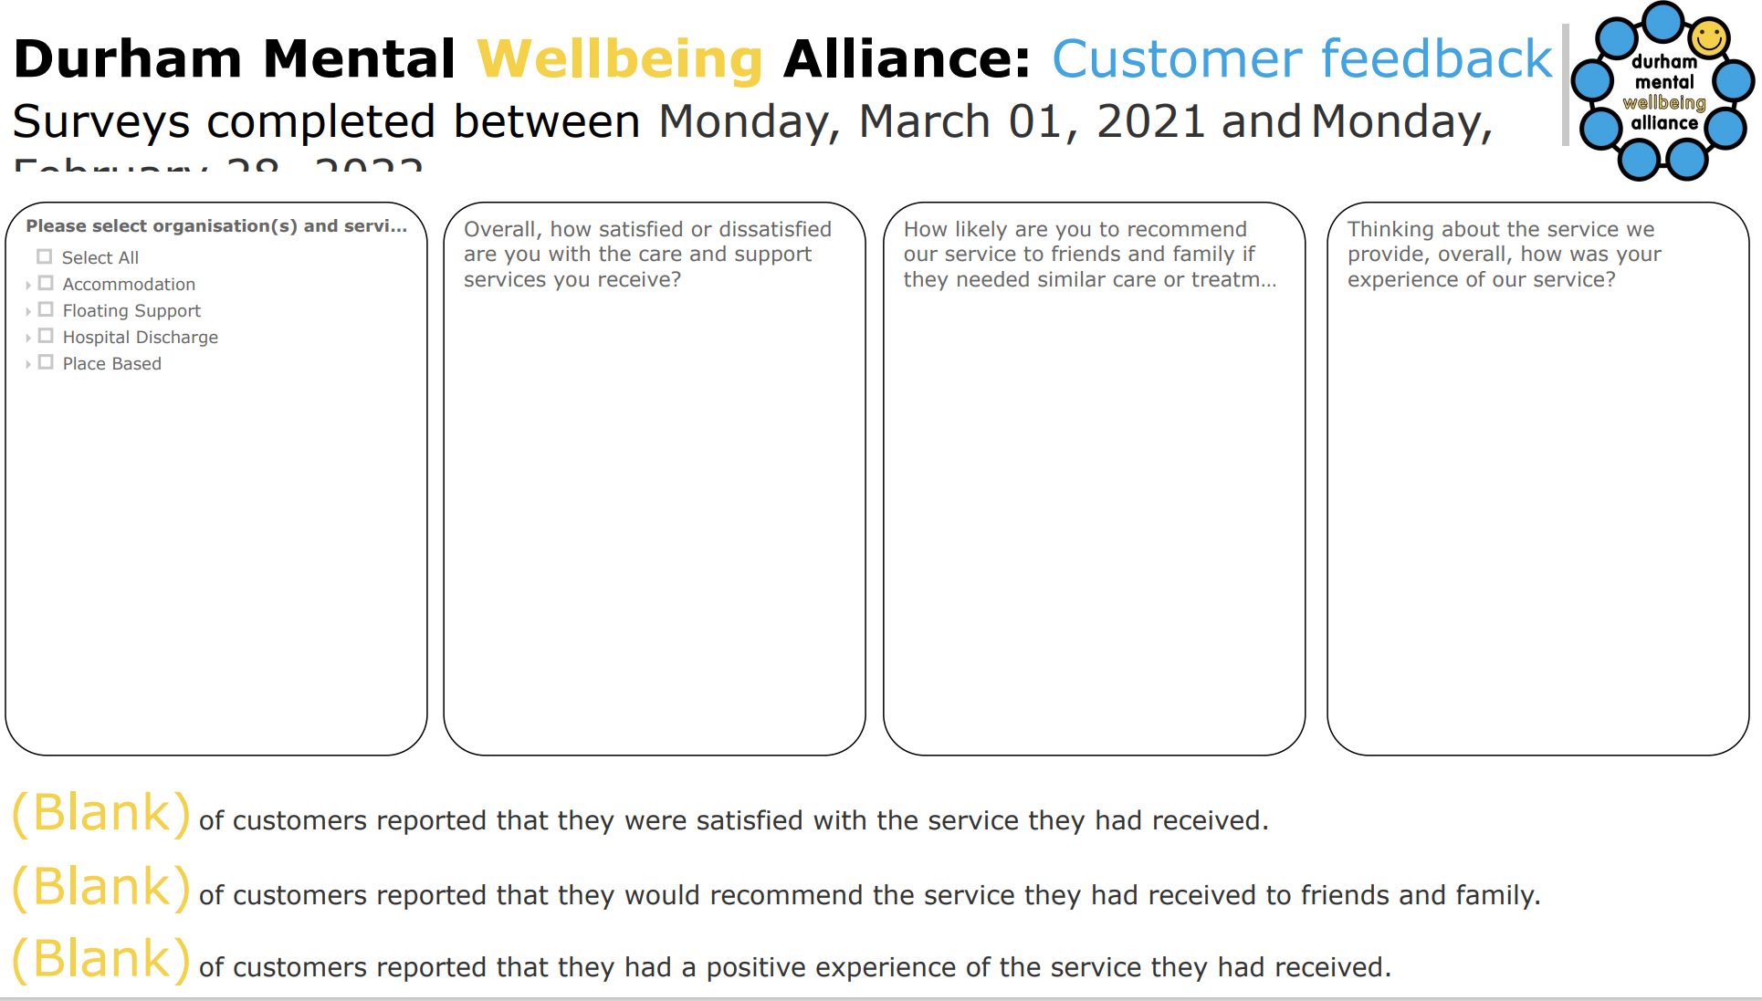
A snippet of the Alliance Performance dashboard: ‘Fake’ data

Slide 22
Any questions?
DWMA@homegroup.org.uk

