Slide 2
Who Are We?
Statutory Partners are Children’s Social Care, Police and ICB (Integrated Care Board) To ensure children are safeguarded and to learn from practice
Supported by other agencies such as Probation, HDFT, CDDFT, TEWV, Education, Early Years, Voluntary Sector, Humankind, Harbour, Public Health
There are lead partners who have oversight
The partnership is “YOU” and every practitioner who works with children
The DSCP business unit supports the work of the partnership

Slide 3

Durham Safeguarding Children Partnership
Team Structure
Business Manager
Paula Mather
Partnership Improving Practice Manager
Laura Bywater
Performance & Programme Co-ordinator
Vicki Vickerson
Partnership Officer
Emma Maynard
Training & Development Co-ordinator
Amy Armstrong
Administration Officer
Tracy Maratty
Administration Assistant
Susan Tweddell

Slide 4
What Do We Do?
Statutory Duties – Assurance
Manage Child Protection Complaints , Oversee Complex and Organised Abuse Process
Licencing Applications
Management of Serious Incident Process and Local Child Safeguarding Practice Reviews
Ensure Learning from near misses, poor and good practice
Manage the strategic business plan which has 4 priority area
Support a number of Sub-groups that manage the work of the DSC
Multi-agency website and newsletter
Multi-agency Procedures
Multi-agency Training programme (14), E-Learning (30) and Bespoke Offer

Slide 5
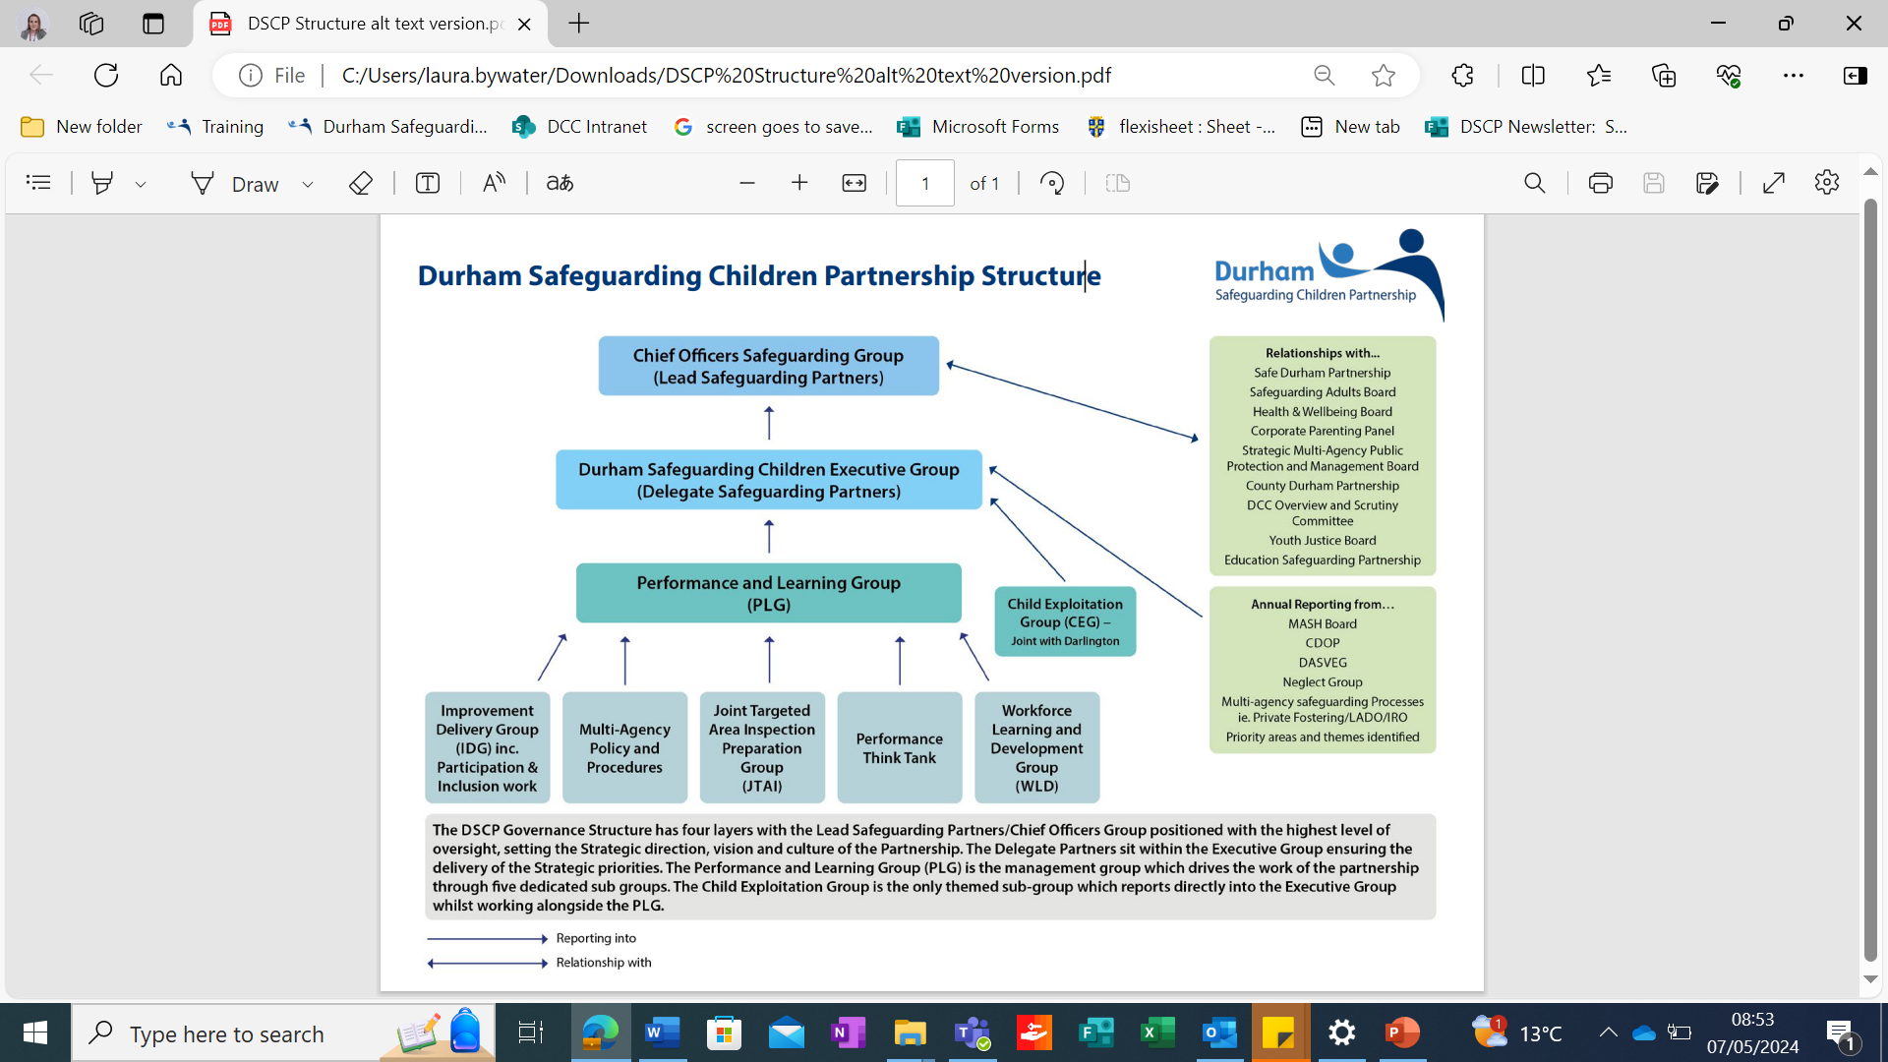

Slide 6

Priorities
PRIORITY ONE - DOMESTIC ABUSE
PRIORITY TWO - HARM OUTSIDE THE HOME
PRIORITY THREE - FIRST 1001 DAYS
PRIORITY FOUR - MENTAL HEALTH AND WELLBEING
Golden Threads - that weave through everything we do….
Child’s Voice and Lived Experience
Working Together Across Partners and Boundaries
Whole Family Approach recognising Networks, Father’s Roles and Hidden Males
Cultural Competence
Reflective Practice
Signs of Safety

Slide 7
Learning Cycle
Month One Phase One – Practice Learning Group scoping of theme and key lines of enquiry, agreeing the Improvement Delivery Group
Month One Phase Two– Improvement Delivery Group Planning and agreeing Methodology and TOR
Month Two – Phase Three Improvement Delivery Group Doing, mechanism of work
12 Months – Phase Six
Review, Reflection and Assurance
Month Four – Phase Five Improvement Delivery Group
Reflection and Action Plan
Month Three – Phase Four Improvement Delivery Group Sharing Learning and collecting feedback from professionals, family and children

Slide 8
Key Messages

Slide 9

Practice Reviews
6 Serious Incidents Since Dec 2021
3 Learning from Practice Revies 2023
3 Common Themes
Information Sharing
Cross Boundaries
Professional Curiosity
What do we need to change to stop this pattern ……………

Slide 10
Information sharing – How We Share in Durham
To provide the right help at the right time often means sharing personal information about people with relevant professionals and partners.
“Lack of appropriate and timely sharing of information between safeguarding partners is a theme in national and local reviews of practice. Almost half of local child safeguarding practice reviews (LCSPRs) highlight issues relating to information sharing” (Dickens et al., 2021).
Working Together to Safeguard Children 2023 (Gov.uk) outlines the requirements for safeguarding partners and multi-agency safeguarding arrangements (MASA) to have robust information sharing arrangements in place to support sharing for safeguarding purposes.
Working closely with the Department for Education, the DSCP have recently developed our Tier 1 Information Sharing Agreement which is a multi-agency agreement that details the lawful basis for sharing information. The Tier 1 agreement is available via our multi agency procedures – see Information Sharing (trixonline.co.uk).
We have also developed an online learning package available via DSCP Course Centre. The modules include learning from practice in Durham, the definition of safeguarding in the context of information sharing (a strong emphasis on prevention) and also a shift in culture relating to consent to share information to sharing within the lawful basis of ‘public task’.
The learning package highlights key points and is supported by a range of key guidance, including the following:
DfE non statutory information sharing advice for practitioners providing safeguarding services for children, young people, parents and carers (PDF on publishing.service.gov.uk)
A 10 step guide to sharing information to safeguard children (ICO)
Information Commissioner, John Edwards: Think. Check. Share. Data sharing to safeguard a child at risk of harm
Working together to safeguard children 2023: statutory guidance (PDF on publishing.service.gov.uk) (Chapter 1, Page 18)

Slide 11
Information Sharing - Information Sharing is Everyones Responsibility
Understanding “safeguarding”
The Department for Education defines children’s safeguarding as follows within their ‘Working Together to Safeguard Children 2023’ guide to inter-agency working to safeguard and promote the welfare of children:
providing help and support to meet the needs of children as soon as problems emerge
protecting children from maltreatment, whether that is within or outside the home, including online
preventing impairment of children’s mental and physical health or development
ensuring that children grow up in circumstances consistent with the provision of safe and effective care
promoting the upbringing of children with their birth parents, or otherwise their family network through a kinship care arrangement, whenever possible and where this is in the best interests of the children
taking action to enable all children to have the best outcomes in line with the outcomes set out in the Children’s Social Care National Framework.
Safeguarding must therefore be seen as a protection of wellbeing (including physical, mental & emotional); a prevention of harm and reduction of risk through care and support requiring information sharing. This allows intervention in immediate situations demanding the safeguarding of children and individuals but also sharing for prevention and early intervention in less immediate or high-risk situations. It may be that the risk of harm to a child can only be identified and understood through the early sharing of concerns between those that hold relevant information.

Slide 12
Information Sharing
The Information Commissioner’s Office (ICO) recognises in their 10-step guide to sharing information to safeguard children that there is no single definition of safeguarding but highlights the inclusion of
a. preventing harm;
b. promoting the welfare of a child; and
c. identifying risk in order to prevent harm (especially helpful where the risk may not be obvious to a single person or organisation).
Understanding - information sharing in a safeguarding context means the appropriate and secure exchange of personal information, between practitioners and other individuals with a responsibility for children, in order to keep them safe from harm.
This advice relates to sharing case-level information about individual children and, where necessary, information about family members and other people who might – through their actions or neglect – put a child at risk of harm. This includes informal sharing of information between practitioners to develop an accurate understanding of a child or family, and more formal processes of sharing information such as referrals into local authority children’s services.
Sharing must be necessary, fair, proportionate, relevant
Justification - Sharing information for safeguarding purposes can be justified solely based on preventing harm to a child. The sharing of this information is not dependent on any thresholds for intervention. For example, it is not necessary for a formal process under section 17 or section 47 to be invoked in order for information to be shared, provided that the sharing is necessary for organisations and agencies to safeguard a child at possible risk of harm.
It is only through sharing information that agencies or organisations and practitioners build a richer picture of the day-to-day life of the child and family they are working with.

Slide 13
Information Sharing
The importance of sharing information
Information sharing is essential for identifying patterns of behaviour, or circumstances in a child’s life that may be evidence that they are at risk of harm or are being harmed and need some form of support or protection.
This includes but is not limited to:
• child abuse, neglect or exploitation
• situations where timely supportive intervention could prevent concerns about a child’s wellbeing from escalating
• when a child is at risk of going missing or has gone missing
• when multiple children appear linked to the same risk
• where there may be multiple local authorities and agencies or organisations involved in the care of a child’s care
Where you have concerns about a child and are unsure if they are at risk of harm, be open to contacting other practitioners who have contact with the child and sharing limited information with them, to see if they hold additional information which gives cause to believe the child is at risk of harm.

Slide 14
Information Sharing
Information should be shared by identifying a Lawful Basis - The most common lawful bases suitable for safeguarding purposes are public task, legitimate interests and legal obligation.
https://ico.org.uk/for-organisations/uk-gdpr-guidance-and-resources/data-sharing/a-10-step-guide-to-sharing-information-to-safeguard-children/
Use Guidance – Advice for Practitioners inc Seven Golden Rules for Sharing Information
https://www.gov.uk/government/publications/safeguarding-practitioners-information-sharing-advice
Consent – Consent should not be used as a lawful basis. If you would still share information using a Lawful Basis if Consent were refused or withdrawn, then seeking Consent from the individual is misleading and inherently unfair. It presents the individual with a false choice and only the illusion of control. You must identify the most appropriate lawful basis from the start
Not seeking Consent does not mean do not communicate. You should Engage, Explain and seek Co-operation. It is important to be upfront, transparent and honest with children and families where safe to do so in order to build trusted relationships. Transparency “Right to be Informed”
Consent to engage with services is not the same It may be necessary to share information even if the threshold for service intervention (for example, under s.17 of the Children Act 1989) has not been reached or where a person does not agree to the provision of particular services as consent to share information
Balancing Confidentiality and Human Rights
Use Durham’s Tier 1 and Tier 2 Agreements these set good practice standards for Durham Welcome to the Durham Safeguarding Children Partnership Procedures Manual (proceduresonline.com)

Slide 15
Key messages when Families move across Boundaries
The child's welfare should always be paramount, and voice of the child considered
Decision making should always be in the best interests of the child
Ensure up to date family details
Ensure that any assessments and plans reflect current needs and risk
Clear Communication between Local Authority’s
Negotiations and agreements by Managers
Timely and accurate Information Sharing with receiving Authority’s
Updating all practitioners currently involved with the family
Consider impact of moving areas on the family and reflect additional stressors in assessments and plans
When Families move frequently, it is more difficult for agencies to identify risks and monitor a child’s welfare. All practitioners across agencies should be alert to the possibility that a child and family who have moved may have moved to conceal risk factors and/or to avoid intervention from both Universal and Targeted Service.
Remember…. Families do not have to have Social Work or known safeguarding interventions to be concealing concerns, and these are often our highest risk families.
Regional Information Sharing Agreement Welcome to the Durham Safeguarding Children Partnership Procedures Manual (proceduresonline.com)

Slide 16

Professional Curiosity
It means:
testing out your professional hypothesis and not making assumptions
triangulating information from different sources to gain a better understanding of individuals and family functioning
getting an understanding of individuals’ and family's history which in turn, may help you think about what may happen in the future
obtaining multiple sources of information and not accepting a single set of details you are given at face value
having an awareness of your own personal bias and how that affects how you see those you are working with
being respectfully nosey

Slide 17
Why does this matter?
When working with families, much of the information and insight into the family comes from them directly and is ‘self-reported’.
Professionals need to ensure that they triangulate what parents are saying by establishing the facts, gathering evidence, and communicating well with all involved.
There is a need for all professionals to have a conscious and healthy inquisitiveness, not taking information at face value but clarify, reflect what they are being told and verify information.
It is important to make it clear in recording the origin of a piece of information and if it self-reported, this avoids the risk of it becoming assumed as fact through the passage of time.
Wherever possible, check out details of self-reported information by asking who, where when and confirm/validate the information.

Slide 18
Clarify
Who is reporting the information, is this first-hand information?
Have I understood this information correctly, can I understand this further, who can I discuss this with?
How can I gather more details. Where, when, who, why, what and how
Top Top: Coordinate a multi-agency supervision to discuss identified concerns or factors. Prepare for any difficult conversations, be ready to respond with respect and empathy.
What is the contact of the information

Slide 19
Reflect
How does this new information impact upon my understanding of strengths, vulnerabilities, and risks?
What is the impact of this information on the child?
Do I need to change my approach to working with the family in light of this information?
Top Tips: Make time and space in your working day to pause and reflect on what you have seen and heard. What do you know for sure? What assumptions have you made?

Slide 20
Verify
Who can confirm accuracy of the information?
Has consent been sought to share information with others or gather further information to confirm?
Triangulate the information you have received.
Establish the facts.
Gather further information.
Top Tips: Discuss any concerns with colleagues, with partner organisations and within your supervision any details that are no clear.

Slide 21


What you can do….. Key Messages
Remember Information Sharing is Everyones Responsibility
Think about how we share information
Do we really share the information effectively
Join up “Pieces of the Jigsaw” so a true picture can be understood
Provide Feedback to “Close the Loop”
Have confidence, trust your instinct and act on your training, experience and risk assessment skills
Seek Guidance
Take time to reflect and step back to look at the wider picture
Don’t be afraid to revisit
Don’t be afraid to challenge and question

Slide 22

Improve Your Knowledge
Complete the Information Sharing Me-Learning session
Be aware of Information Sharing Agreements
Be familiar with Guidance
Use the Clarify, Reflect and Verify briefing
https://ico.org.uk/for-organisations/uk-gdpr-guidance-and-resources/data-sharing/a-10-step-guide-to-sharing-information-to-safeguard-children/
https://www.gov.uk/government/publications/safeguarding-practitioners-information-sharing-advice
Information sharing – How We Share in Durham (durham-scp.org.uk)
E-learning courses (durham-scp.org.uk)
https://durham-scp.org.uk/wp-content/uploads/2024/05/ClarifyReflectVerify.pdf
10 step guide to sharing information to safeguard children

