Slide 1
Durham Skills Boost

Slide 2
Contents.
EDT – Who we are
Overview of course
Benefits and incentives
Course feedback
Further information and referrals
Your support
Questions

Slide 3
Who we are.
ABOUT EDT
We are an international not-for-profit organisation
We work with governments around the world, combining our expertise with global research and regional knowledge to deliver programmes and inform education policy and practice around the world.

Slide 4
Where we work.
UK
JORDAN
SIERRA LEONE
ETHIOPIA
BRUNEI
KENYA
RWANDA

Slide 5
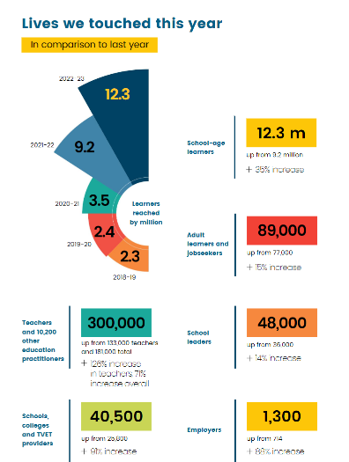
Our impact
In the UK we:
empower teachers by providing high quality professional development opportunities for educators at all levels
provided support to over 4200 educators through our National Professional Qualifications programme
reached 216,000 learners (young people and adults) during 22/23 through our careers, employability and skills programmes working across 2,250 settings across the country
are one of the largest careers employers in the UK with a range of employability and careers provision across the country reaching those who are furthest from education and employment
Have an expanding skills provision, delivering skills bootcamps and literacy-based programmes

Slide 6
What is ‘Durham Skills Boost’?
Durham Skills Boost is part of Durham Learn’s Communicate initiative and is funded by UKSPF.
It is a non-accredited course designed with relatable, everyday context through topic-based learning to increase confidence in literacy, learning and digital skills.
It aims to support individuals with barriers to learning, to progress onto formal qualifications and/or employment.

Slide 7
Incentives and benefits.
Why do the course?
£25 shopping voucher for attending the full course
Up to £100 travel and childcare costs per learner
Improved confidence in literacy, learning and digital skills
Encourages learners to move onto more formal accredited learning
Assistance in next steps in learning and career planning
Option to achieve Level 1 Award in Worker’s Rights and Labour Exploitation (SEG, developed in conjunction with Gangmasters and Labour Abuse Authority)

Slide 8
Course overview.
Duration.
9 GLHs split over 2-3 days
Location.
Venues across North and Central Durham
Content.
Exploring literacy in everyday life, employability and the workplace. Buzz quiz. CEIAG.
The tutor.
Margaret is a friendly and supportive Functional Skills and ESOL tutor, with many years experience of working with learners with different challenges.
Eligibility.
Durham resident
19 plus
Do not have a Level 2 English qualification

Slide 10
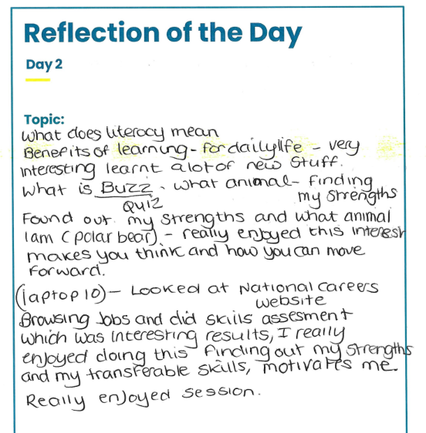
“I loved how Margaret connected with us on a personal level and made the atmosphere really friendly.”
“I enjoyed the session today, as usual Margaret was really friendly and easy to understand..”

Slide 11
Further information and referrals.
Information about Durham Skills Boost can be found at edt.org/dsb
A ‘Register your interest’ form can also be found on the website
Referrals can either be through the ‘Register your interest’ form, or emailed to skills@edt.org
Individuals then contacted to ensure the course is right for them

Slide 12
Your support.
The people we are aiming to support often face significant barriers to learning and therefore, understandably, may need extra encouragement and reassurance to enrol.
You can support us to support them by:
Sharing details about our courses with the relevant people in your network
Encouraging signposting/referring to those the course may benefit
Supporting us to link up with organisations who also support people to improve their lives

Slide 13
Questions

Slide 14
Thank you
Contact us:
Email:
ajaroszkiewicz@edt.org

