Slide 1
Multiply
Sarra Scougall

Slide 2
Background
Did you know?​
17m adults in England (half of the working-age population) have everyday maths skills roughly equivalent to those expected of a primary school child​
​
UKSPF funded Multiply aims, from now until March 2025, to help people improve their ability to understand and use maths in daily life, home, and work e.g.:​
household finances​
helping children with homework​
improving numeracy skills specific to a line of work.​
​
Durham County Council will receive £2.803 million from the Department for Education, across the duration of the project.​
Notes:
My name is Sarra Scougall and I am the Multiply Coordinator at Durham Learn and I manage the Multiply project.
So what is Multiply? In England there are 17m adults or half of the working age population who maths skills similar to those of a primary school child. Therefore as part of the new UK Shared Prosperity Fund the government has invested £560 million to improve that statistic – Multiply
This project is currently operating until March 2025 and aims to improve adults numeracy abilities to support them to:
Improve household finances
Help their children with their homework
Improve sector specific numeracy skills for those in work
Lets have a further look at the intent of the project and how it is relevant for you sat here today…

Slide 3
Aim of Project
By March 2025 we want the project to provide innovative solutions to support thousands of adults in County Durham to:​
Improve confidence with numbers with the hardest to reach​
Improve their children’s attainment in maths and their own progression​. Courses for parents wanting to increase their numeracy skills in order to help their children, and help with their own progression
Achieve maths qualifications up to and including Level 2​
Increase participation in numeracy courses​
Fill numeracy skills gaps reported by employers, supporting people to gain employment and progress in work​
Notes:
Durham County Council have been allocated £2.8 million pounds worth of funding to provide innovative solutions to support thousands of adults through innovative solutions. The project here across County Durham aims to:
Improve confidence with numbers with the hardest to reach​
Help parents and carers improve their children’s attainment and their own progression​
Achieve maths qualifications up to and including Level 2​
Increase participation in numeracy courses​
Fill numeracy skills gaps reported by employers, supporting people to gain employment and progress in work​
So how are we doing this?....

Slide 4
Delivery Model
Engagement
Substantive learning
Delivered by: Multiply Champions/Partners
Duration: from 2hours to 30hours+
Content: Bespoke, contextualised delivery content designed to meet the needs of the learners
Next Steps
Learners progress into formal learning to achieve quals in:
-Numeracy
-Digital Skills
-Vocational qualifications
Delivered by: Multiply Champions
Duration: Up to 2 hours of activity
Content: Informal discussion about numeracy and bitesize numeracy activity
Next Step: Progress into substantive learning
Notes:
Firstly the Multiply Champion will deliver a bitesize engagement activity of up to 2 hours to generate interest in upskilling and establish need
Then if the learner would like to develop their skills further they can join one of our short courses for minimum of 2 hours, again bespoke and contextualised to meet their needs
Then whats next? Progress into a formal qualification or use their skills to support their child, its up to them.

Slide 5
Courses
Course Title | Duration | Overview
Prepare for Care | 12 hours (4x 3 hour sessions) | Develop the number skills and confidence required for activities such as time management, record-keeping, medication, nutrition, shopping and stocks/supplies.
Financial Wellbeing | 4 hours | Delivered in partnership with Financial Ability, will include review of services available to save money and the creation of an individual budget, IT and four rules
Money Matters | 6 x 2-hour sessions | Using notes and coins to make amounts Adding sums of money Calculating and estimating change Percentage amounts of money Calculating interest Calculating discounts Budget spreadsheet
Feed the family | Min of 3 hours | Teaching you the skills you need to feed the family on a budget, including cooking meals for under £5!
Notes:
We have a range of courses available designed in response to learners need from Year 1 of the project. These include….
These are delivered in small groups and we also offer 1-2-1 support for those who require this. This can be delivered face-to-face or online.

Slide 6
Impact So Far
I enjoyed the course, and it has helped me feel more confident with maths and ready to start my Functional Skills course in September. I have been using my skills at work and it has helped me with things such as ordering stock, working out percentages for free school meals.
Year 1 (Dec 2022-23/03/23)
386 engagements and substantive learning activities
Ah, this must be what they are doing in my son's school, he's in reception - it makes so much more sense what he's doing now you've told us this. I'll be able to support him better now
I thought Multiply was very simple to understand because it was everyday situations. If I did not do Multiply, I would have avoided doing any more maths courses.
I learnt new recipes, I learnt how to stretch out the money as well, which is awesome. I would recommend the course to everyone because it’s helpful for anyone who finds it hard to stick to a budget.
Notes:
Year 1 (Dec 2022-23/03/23)
The Durham Learn Multiply Team and our subcontractors and partners delivered 386 engagements and substantive learning activities to adults in County Durham
Here is some examples of feedback from our learners

Slide 7
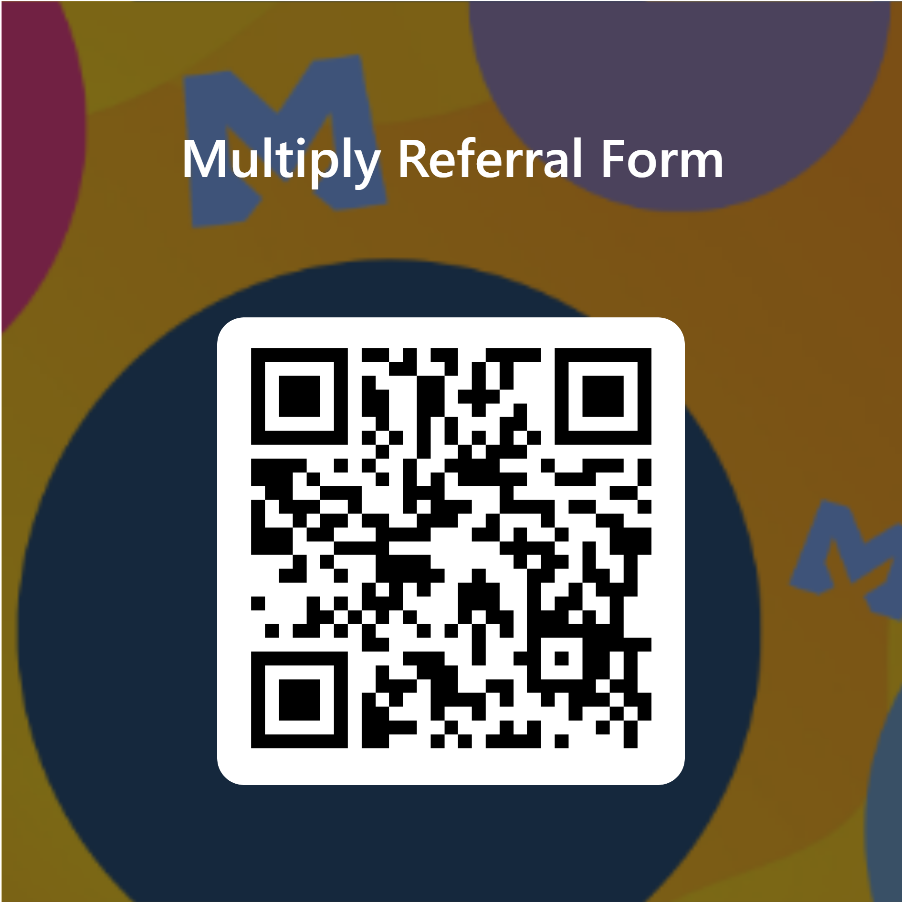
How to get involved?
Referral Process:
Multiply Referral Form
Business Development Officers:
Michelle Morrison michelle.Morrison@durham.gov.uk 07825826758
Julie Duncan Julie.Duncan@durham.gov.uk 07557322717
Notes:
If you have adults who use your service who you think would benefit from the support that Multiply can offer please contact us via the Multiply email address and one of our Champions will be in touch.
If you would like to find out how we can support your organisation by delivering bespoke support for either the staff and volunteers or service users please get in touch with either of our Business Development Officers who will arrange a meeting to discuss training needs

Slide 8
Any questions?

