Slide 1
Janice Rokni Bex Carter
Director Supporting Sister
Co-Founder Volunteer

Slide 2
Our values
Our women only centre in Chester le Street offers holistic, trauma-informed services for women.
W
ELCOMING
I
MPACTFUL
S
AFE
E
MPOWERING

Slide 3
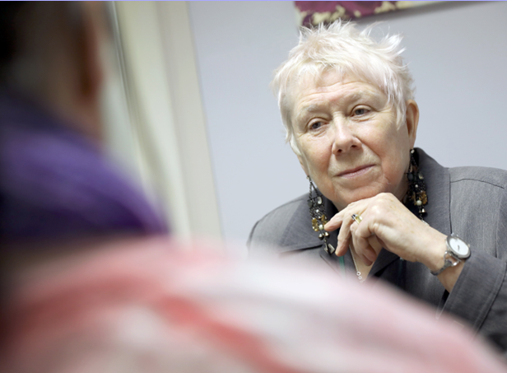
Our approach
Trauma-informed approach
Longer term provision
Holistic support
Mental health
DVA and sexual violence
Suicide and Self-harm
Poverty
Isolation, loneliness
Raising aspirations
Open referrals
Partnership working
Responsive
Peer-led
Peer-led

Slide 4
What we offer
SUPPORT AND WELLBEING SERVICES
All services free to access
LEARNING PROGRAMME
Onsite crèche provision
VOLUNTEERING OPPORTUNITIES

Slide 5
Support and Wellbeing
Our one to one services and group support is delivered by our highly trained, award winning Supporting Sister’ volunteers.
1:1 Listening Service
Group support
Wellness Service
Telephone/online support
Targeted Support

Slide 6
LEARNING PROGRAMMES
Personal development – Confidence, self esteem and
aspiration building
Health and wellbeing
A Arts and crafts
I.T.

Slide 7
VOLUNTEERING - SUPPORTING SISTERS’
Volunteering at the heart of the support services
aaAward winning, Highly commended Self Care Innovation award 2021
Winner of County Durham Together Awards–Health and Wellbeing
2021, Winner of Volunteer of the Year DCC
Co produced – consultations
Peer led
Women with lived experience
Regular group support for each other - Mentoring

Slide 8
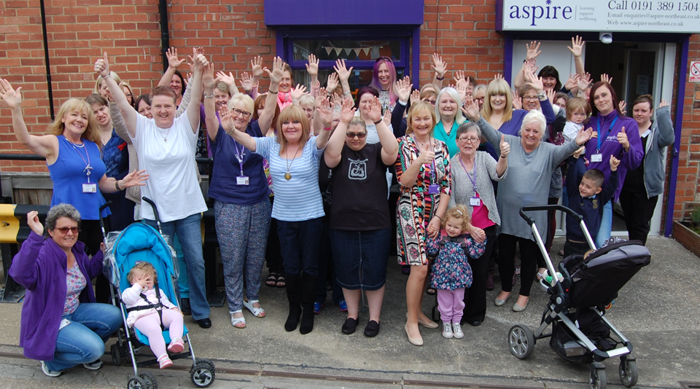
Learning Programme
We are currently delivering blended learning opportunities, including both online and onsite courses for women across a wide range of subject areas.
Arts and Crafts
Skills and interests
Personal development
Health and Wellbeing

Slide 9
THANK YOU TO ALL OUR FUNDERS AND SUPPORTERS

Slide 10
“I didn’t know what self care was until I started coming [to Aspire]”
“Coming to Aspire has helped me to start to live again”
“[During Lockdown] we didn’t have the centre to go to, but we still had each other, which was lovely. We were still there. We’re still here now, aren’t we!”
Thank you for having us!
Aspire House
Rear of Front Street
Chester-le-Street
Co. Durham
DH3 3AW
Tel. 0191 389 1504
Email: sisters@aspire-northeast.co.uk
www.aspire-northeast.co.uk
“The Aspire group online has been a lifeline to me”
Facebook.com/aspire.northeast Twitter @AspireHouse

