Slide 1
Young and Homeless 2021

Slide 2
- Key issues and statistics
- Why its important
- Assumptions and Austerity
- I’ll know I can live independently when I have…..
- County Durham issues and opportunities

Slide 3
- Key issues and statistics
- Young people aged 18-24 were the only age group who saw an increase between 2019/20 and
2020/21 in statutory homelessness.
- Throughout the pandemic, young people at risk of homelessness were vulnerable to volatile housing situations.
- Sofa surfing was removed as an option for many people, making their homelessness more visible, alongside the impact and pressure repeated lockdowns had on increasing family breakdown.
- Homeless young people have needs outside of just housing, and need specialist support to help them make successful transitions into independence.
- The most common support need identified by providers was lack of independent living skills
(71%) followed by mental health (64%)

Slide 4
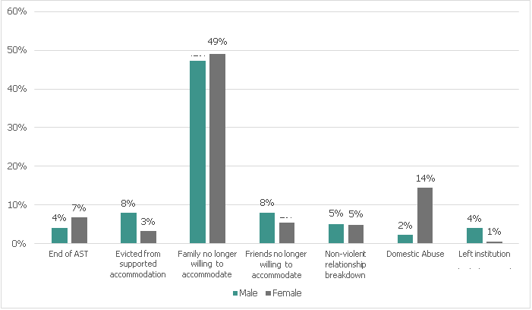
Causes of homelessness by gender for households aged 18 - 24 2020/21

Slide 5
Total England Households aged 16 -24 owed a duty under the HRA
Age profile of Homeless Young People 2021

Slide 6
Support needs of young people accessing homelessness

Slide 7
- Why it’s important
- Our young people are at the outset of their adult lives. They are young and have the potential to be successful, to find work, have families and contribute to society.
- Many have experienced homelessness for the first time, and their issues are not as entrenched as more experienced rough sleepers.
- Through the provision of trusted, reliable and consistent support at a young age, we can help to turn young people’s lives around and help to prevent issues becoming chronic.
- There are opportunities to help to reduce repeat homelessness and the social, emotional, financial and behavioural challenges that result.
- We can help prevent homelessness by working with community partners to identify at risk young people and provide guidance to help them make positive choices.

Slide 8
- Assumptions and Austerity
-A default assumption in much government policy is that young people have a family who can provide at least some practical support and a ‘safety net’; young people who are not in this position often just do not ‘fit’ into processes.
- Austerity has had a severe impact over the past decade. It impacts services that young people affected by homelessness need like housing, health, mental health, and the police.
- Universal credit policies have massively impacted on young homeless people, through delays in payment and sanctioning, access to properties and property type.
- Labour market opportunities for young people do not support a move to stable housing.
- Low wages, zero hours contracts, personal and financial difficulties around the shift into employment are all problematic.

Slide 9
Primary Outcomes
Good tenancy management skills
Understanding of my place/role in society
Good physical and mental health.
I’ll know I can live independently when I have…..
Ability to manage my money and personal admin.
A meaningful and purposeful use for my time.
A healthy attitude to substances.
Self-care living skills for well-being and independence.
A clear sense of personal motivation and responsibility.
Actively considered my mental health.
Intermediate Outcomes
Positive community behaviour.
Strong social networks and relationships.
Responsibility for my own physical health.

Slide 10
- County Durham Issues and Opportunities
- Over 50% of the Moving On client population now come from a ‘leaving care’ up from 22% in 2018.
Waiting lists are the norm, currently at around 80 yp aged 17-25.
- Benefit restrictions mean that most under 35s need to access 1 bedroom accommodation, which is rare or face significant additional costs. The rural nature of the county necessitates housing young people in town centre locations with greater access to resources and away from the ‘villages’.
- Vulnerable young people are getting ‘sucked into’ employment before they have the skills and abilities to sustain work, destroying their entitlement to benefit and support before losing their jobs often quickly….unregulated and potentially unsafe ‘cash in hand’ work is growing quickly in the economic crisis today.
- There are real benefits to be had from locality partnership working where young people can grow their confidence, self-esteem and skills by joining in with their own local community. Over reliance on grant funding is a significant barrier to support as sector based funding is skewed towards maintenance.

